Slide 1
Problem Statement
Detect Pixelated Image and Correct it

Slide 2
Unique Idea Brief (Solution)
An autoencoder is a type of neural network designed to learn efficient data representations. It consists of two main parts: an encoder and a decoder. The encoder compresses the input data into a lower-dimensional latent representation that captures the essential features. The decoder then reconstructs the original data from this compressed form. Autoencoders are particularly useful for tasks like image denoising, where the network is trained to remove noise from images. During training, the autoencoder learns to minimize the difference between the noisy input images and the clean output images. This process allows the network to ignore the noise and focus on the important features, resulting in cleaner, more robust image reconstructions.

Slide 3
Features Offered
Non-linear Learning: Autoencoders capture complex, non-linear relationships within data that linear methods often miss. This ability allows them to model intricate patterns and interactions, making them effective for tasks like image processing and natural language understanding.
Dimensionality Reduction:Autoencoders reduce data dimensions by compressing inputs into a lower-dimensional latent space. This efficient representation retains essential features, making data storage and processing more manageable without significant information loss.
Noise Robustness:Autoencoders enhance noise robustness by learning to focus on important data features while ignoring noise. This results in more accurate and cleaner reconstructions, improving the quality of tasks like image denoising.

Slide 4
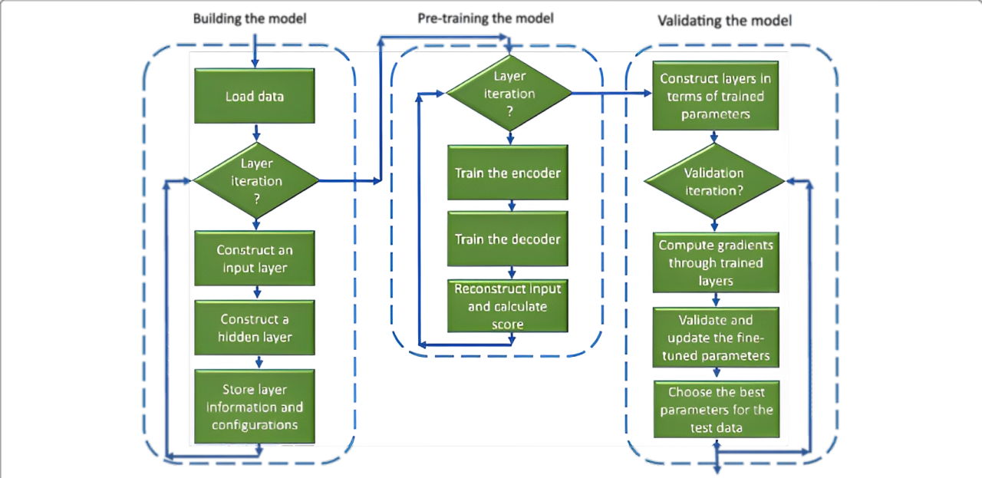
Process flow

Slide 5
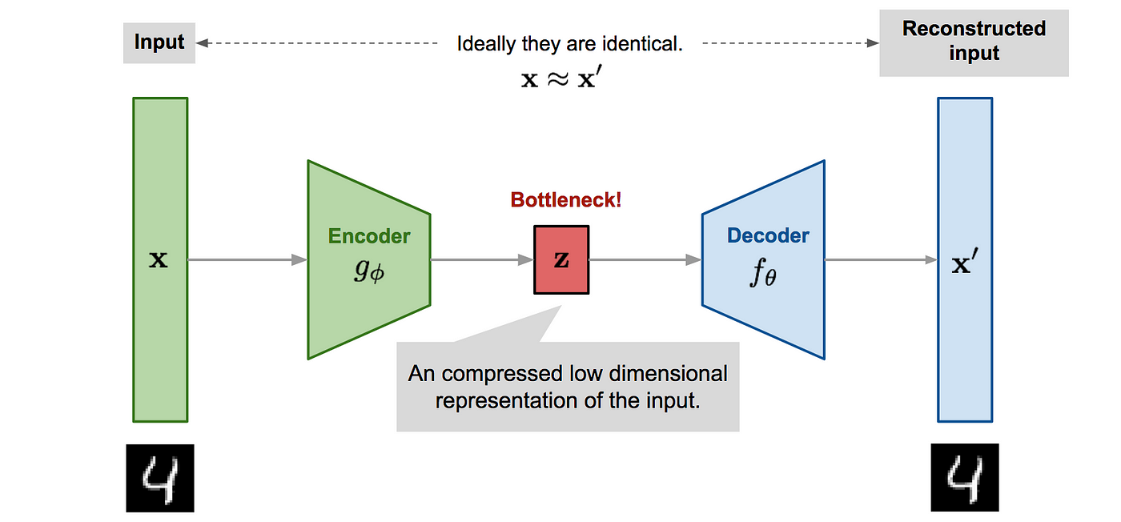
Architecture Diagram

Slide 6
Technologies used
Python Libraries:
Keras
Matplotlib
NumPy
Sklearn
PIL
IDE:
Google Colab
Datasets:
Microsoft Bing

Slide 7
Team members and contribution:
No.of Members: 1
Name: Anto Aswin Herts J
Contribution:
Researching
Model Building
Testing of Model

Slide 8
Conclusion
In summary, our autoencoder project has effectively employed advanced neural network frameworks to learn compact data representations. Through convolutional neural networks and variational techniques, we achieved strong capabilities in reducing dimensionality and removing noise, especially notable in tasks such as image denoising. This project underscores the versatility of autoencoders across applications requiring precise data representation and robustness against noise, promising continued advancements in machine learning and artificial intelligence.

